Slide 1
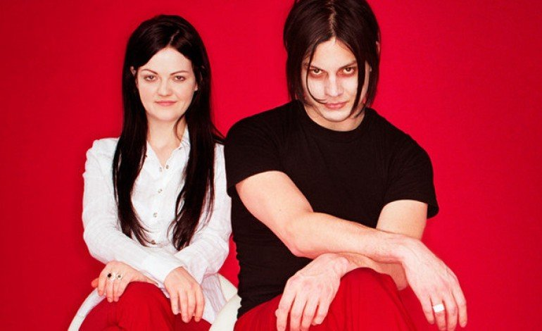

What music are we listening to?
FACTS
Rock band
Jack: guitarist and singer
Meg: Drummer
Brother and sister
Musicians: The White Stripes
Song: We're going to be friends

Slide 2
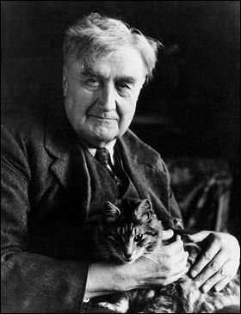
What music are we listening to?
FACTS
Born in Gloucestershire in 1872
Died in 1958
Genre: 20th Century Classical
Ralph Vaughan Williams grew up in a small village in the English countryside and loved English folk songs, so he arranged some for an orchestra in this piece. The performance is done by the Nuremburg Symphony Orchestra.
English Folk Songs Suite was composed in 1923
Musician: Vaughan Williams
Song: English Folk Songs Suite

Slide 3
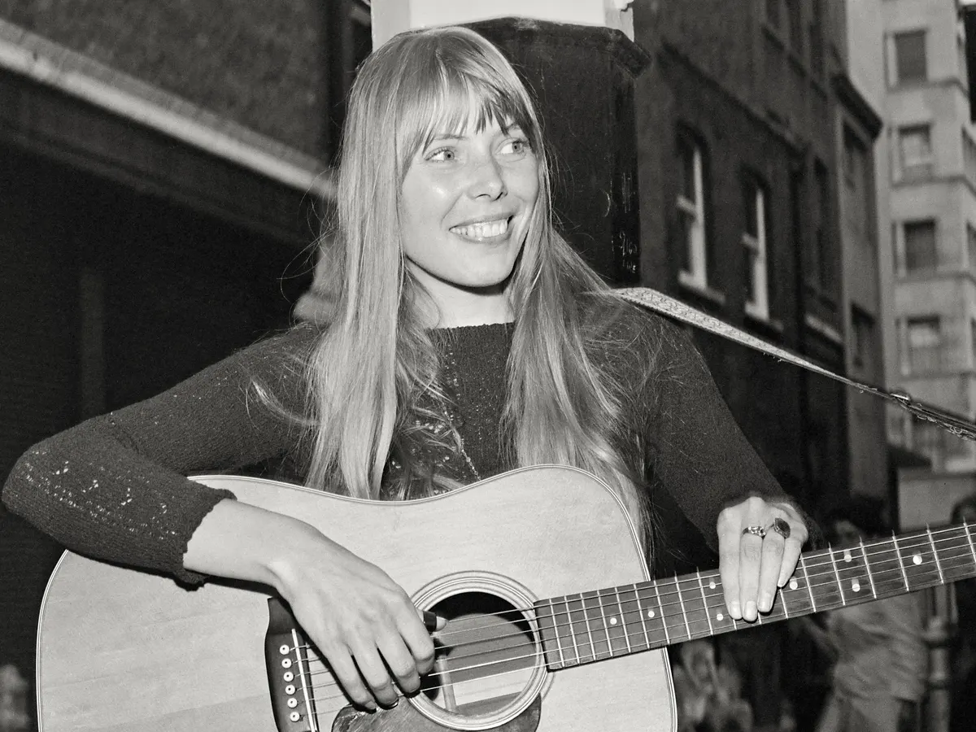
What music are we listening to?
FACTS
Born in Canada in 1943
Genre: Indie, Singer/songwriter
Joni Mitchell is a singer and songwriter from Canada although she lived in the USA for many years. She is most famous for her songs she plays on the acoustic guitar.
‘Big Yellow Taxi’ was released in 1970
Musician: Joni Mitchell
Song: Big Yellow Taxi

Slide 4
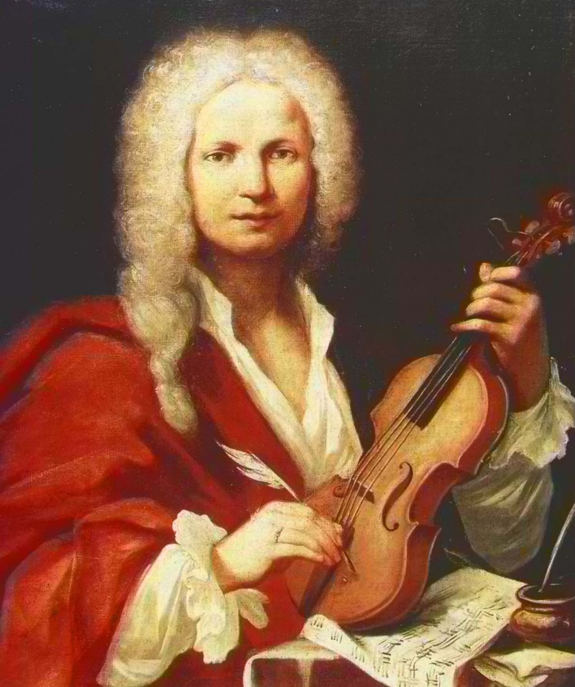
What music are we listening to?
FACTS
Composer, violinist
1678-1741 Italian
Regarded as one of the greatest Baroque composers. Was also a teacher and a priest.
Composer: Antonio Vivaldi
Song: Autumn

Slide 5
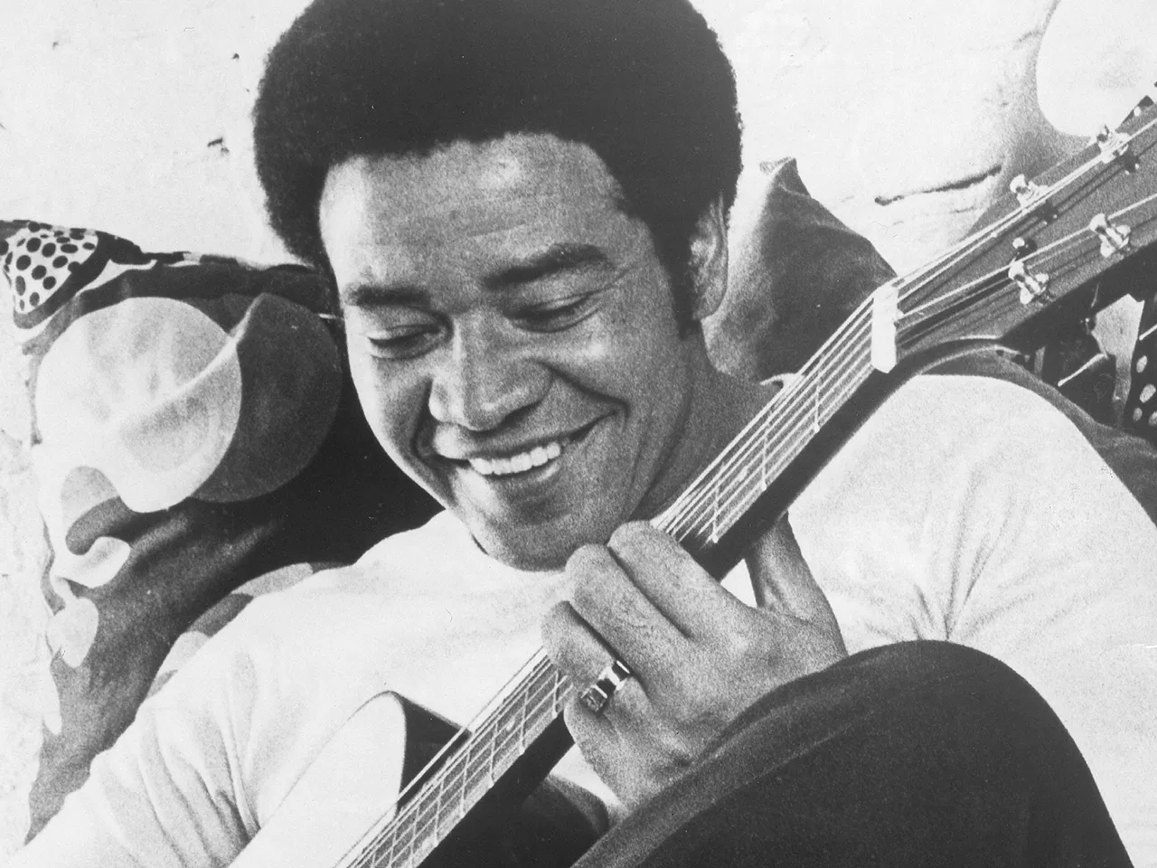
What music are we listening to?
FACTS
Born in West Virginia in 1938
Died 2020
Genre: Soul, RnB
Bill Withers is an American singer and songwriter famous for his combination of pop with soul and funk music. He is also a very talented multi-instrumentalist as although in this video he is playing the guitar, he is also plays the piano!
‘Ain’t no Sunshine’ was released in 1971
Musician: Bill Withers
Song: Ain't no Sunshine

Slide 6
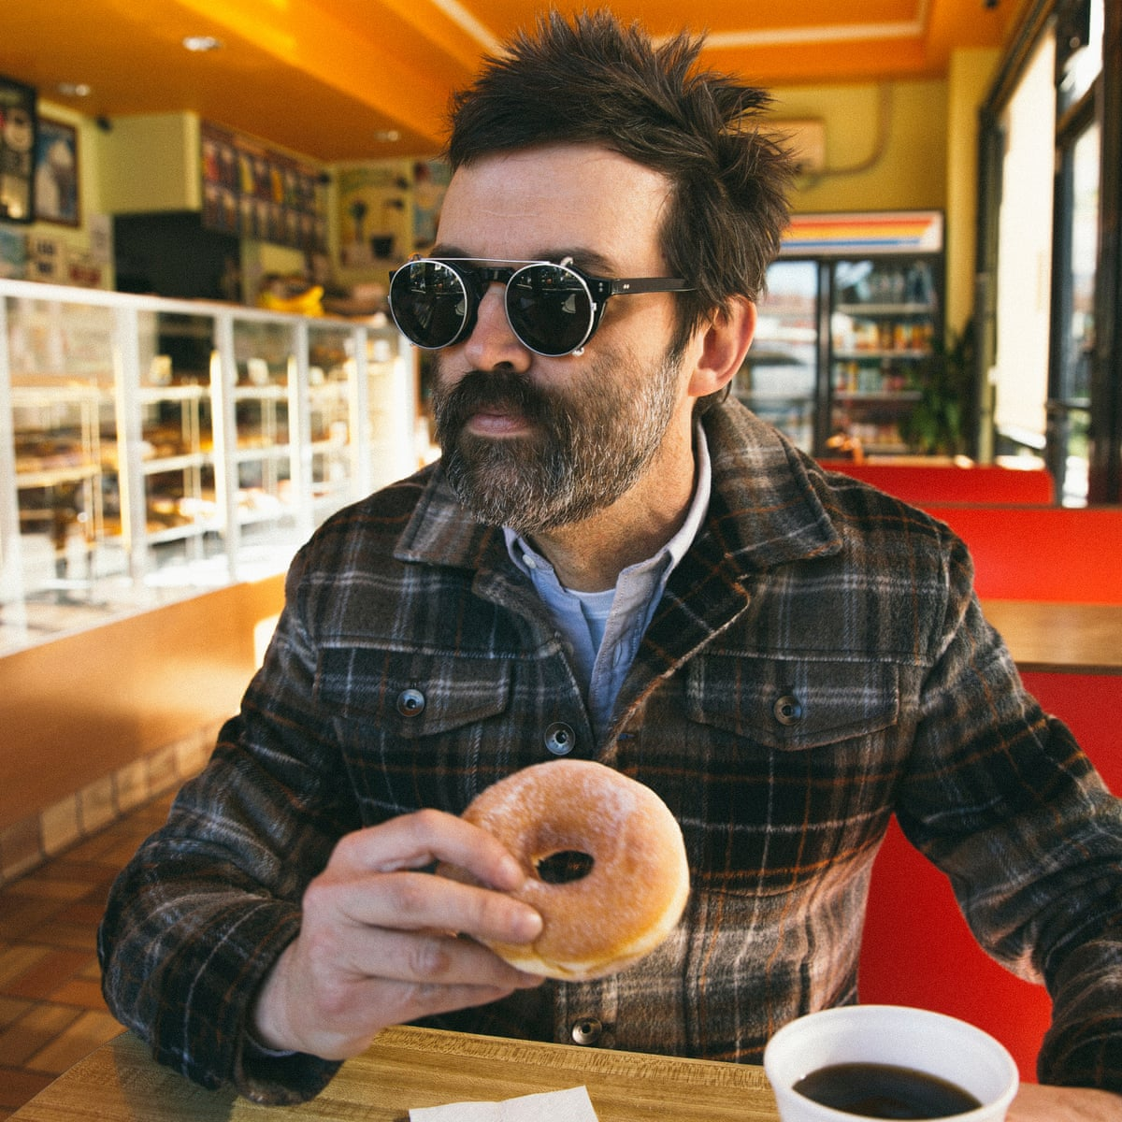
What music are we listening to?
FACTS
Band from Los Angeles
Formed in 1991
Genre: Rock, Alternative
Eels are a band led by frontman Mark Everett who writes all of the songs. This song is about how he loves to watch the birds that fly in his garden.
‘I Like Birds’ was released in 2000
Musician: Eels
Song: I Like Birds

Slide 7
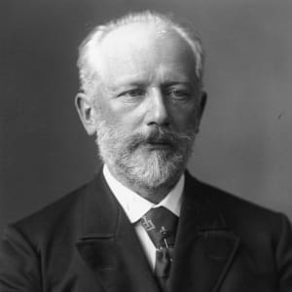
What music are we listening to?
FACTS
The first Russian composer whose music would make a lasting impression.
Lived 1840-1893 Russia
Also composed for ballets Sleeping Beauty, Romeo and Juliet, Nutcracker.
Composer: Pyotr Ilyich Tchaikovsky
Song: The dance of the sugar plum fairy

Slide 8
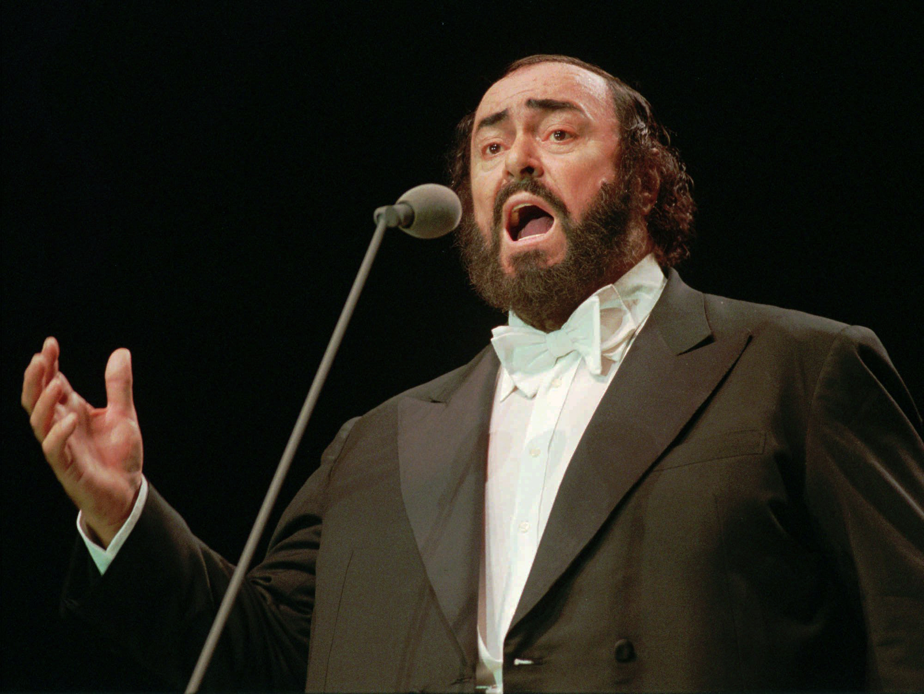
What music are we listening to?
FACTS
Lived 1935-2007.
He was Italian.
He was a tenor and was considered one of the finest opera singers of the 20th century.
His last public appearance was in the opening ceremony of the 2006 Winter Olympics in Turin, Italy, where he sang his signature aria, Puccini’s Nessun dorma.
Singer: Luciano Pavarotti
Song: Nessun dorma

Slide 9
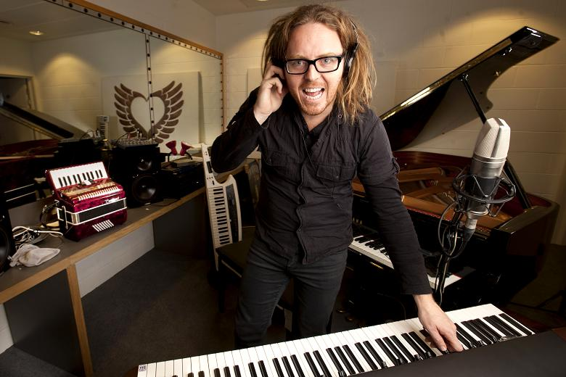
What music are we listening to?
FACTS
He is a British born Australia in 1975.
Tim is an actor, comedian, composer, songwriter, pianist and director.
Matilda has been voted Best West End Show twice and has a total of 47 awards across the UK and the USA.
Tim also wrote the music and lyrics to Groundhog Day.
Composer: Tim Minchin
Song: When I grow up

Slide 10
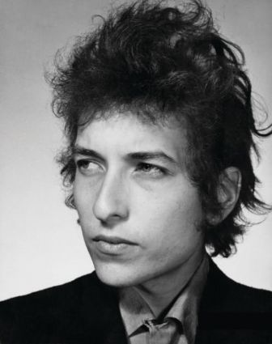
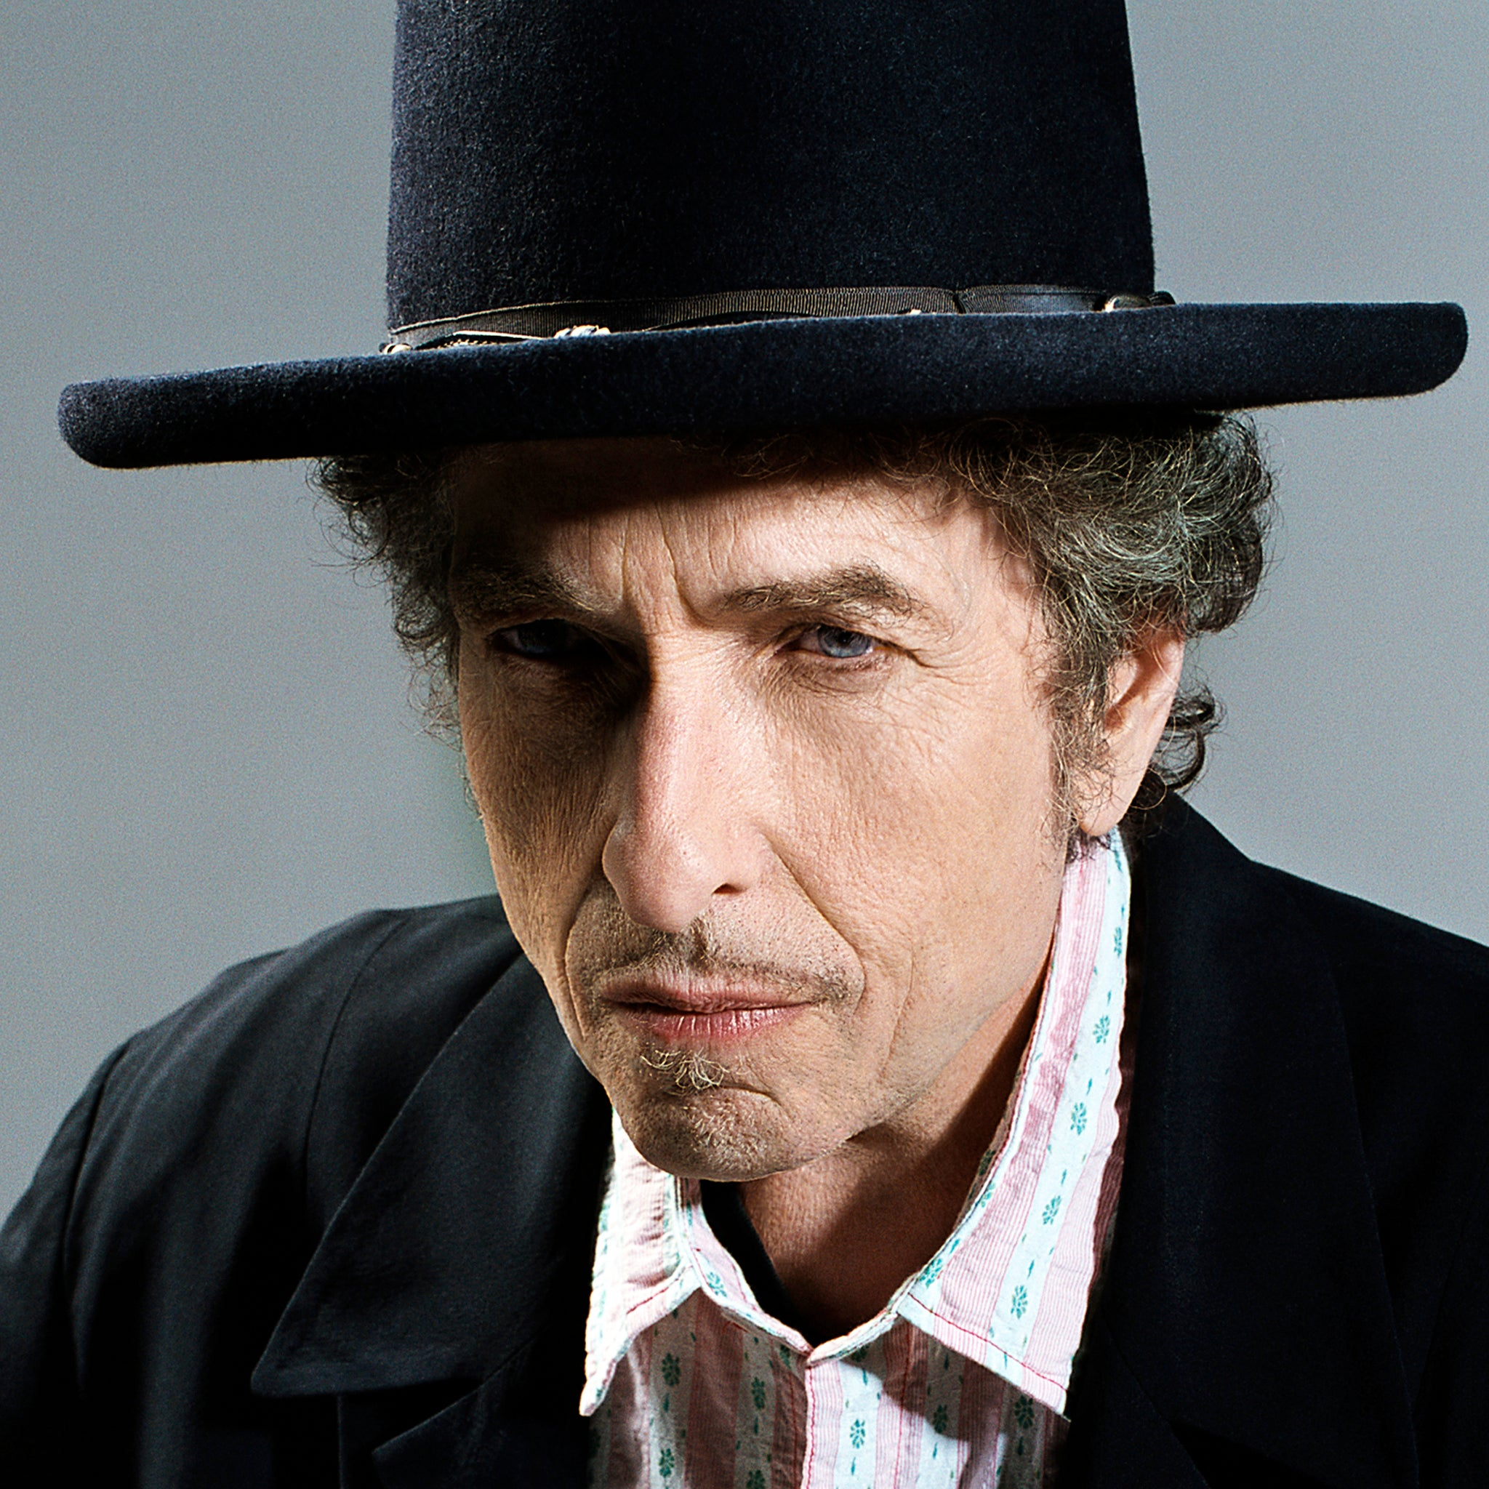
What music are we listening to?
FACTS
Born in 1941 in Minnesota, USA.
He is a singer-songwriter, pianist, guitarist and harmonica player. His lyrics are considered very poetic. He is one of the most successful musicians ever.
He has been a solo artist and has been a member of many bands too.
His paternal grandparents emigrated from the Russian Empire (now Ukraine.)
Singer: Bob Dylan
Song: Mr Tambourine Man

Slide 11
What music are we listening to?
FACTS
Born in 1941 in Minnesota, USA.
He is a singer-songwriter, pianist, guitarist and harmonica player. His lyrics are considered very poetic. He is one of the most successful musicians ever.
He has been a solo artist and has been a member of many bands too.
His paternal grandparents emigrated from the Russian Empire (now Ukraine.)
Singer: Bob Dylan
Song: Mr Tambourine Man

Slide 12
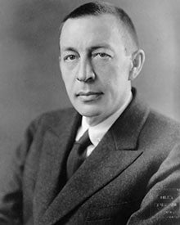
What music are we listening to?
FACTS
He was Russian and lived from
1873-1943.
He moved to the USA after the Russian Revolution in 1918.
Composer, virtuoso pianist and conductor. Considered to be one of the finest pianists of his time.
He was influenced by Tchaikovsky.
Composer: Sergei Rachmaninoff
Song: Prelude in C# minor

Slide 13
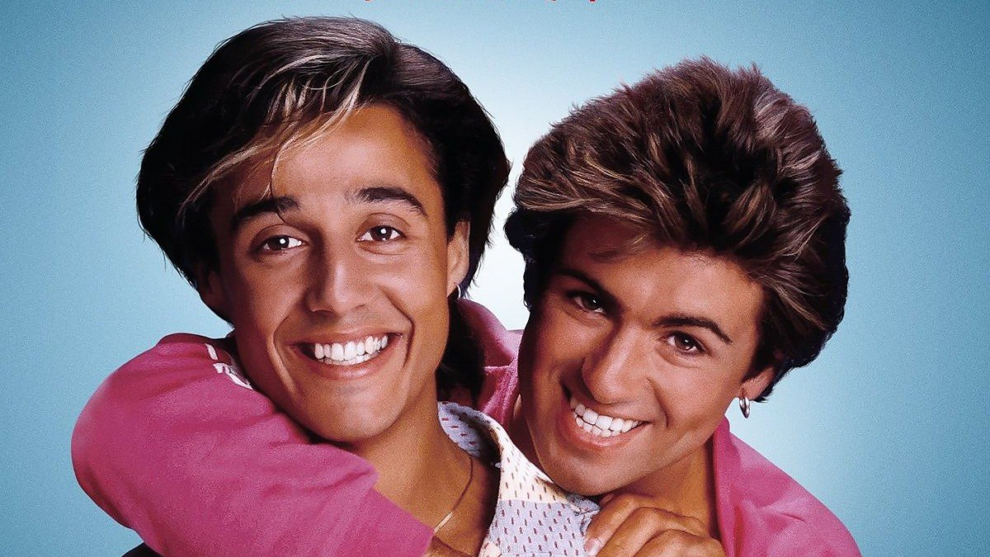
What music are we listening to?
FACTS
Wham! is George Michael and Andrew Ridgeley.
They met at school in Bushey. Wham were together form 1981-1986. George continued a successful solo career after this.
Both men are British and George was of Greek origin. He died in 2016.
George was very generous and donated a lot of money to charity.
Singers: Wham!
Song: Last Christmas

Slide 14
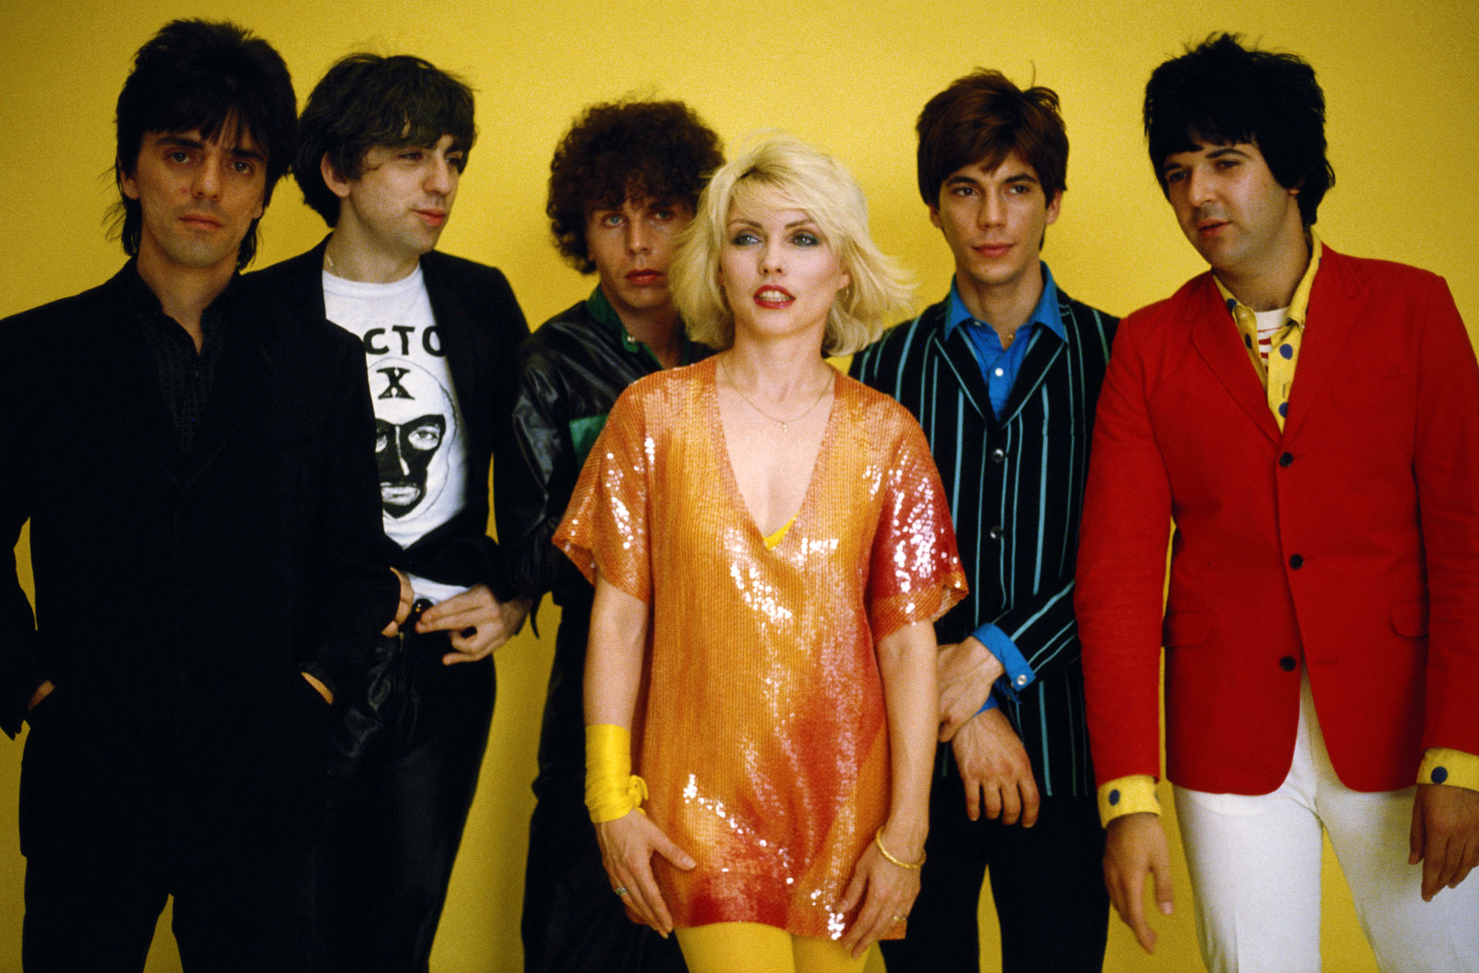
What music are we listening to?
FACTS
The lead singer is Debbie Harry who founded the rock band in 1974 with the guitarist Chris Stein.
Their music was punk rock and pop. They broke up in the 1980s but have recently been touring again.
They were a very successful band and influenced other artists like Madonna, Lady Gaga and The Killers.
Singers: Blondie
Song: Hanging on the telephone

Slide 15
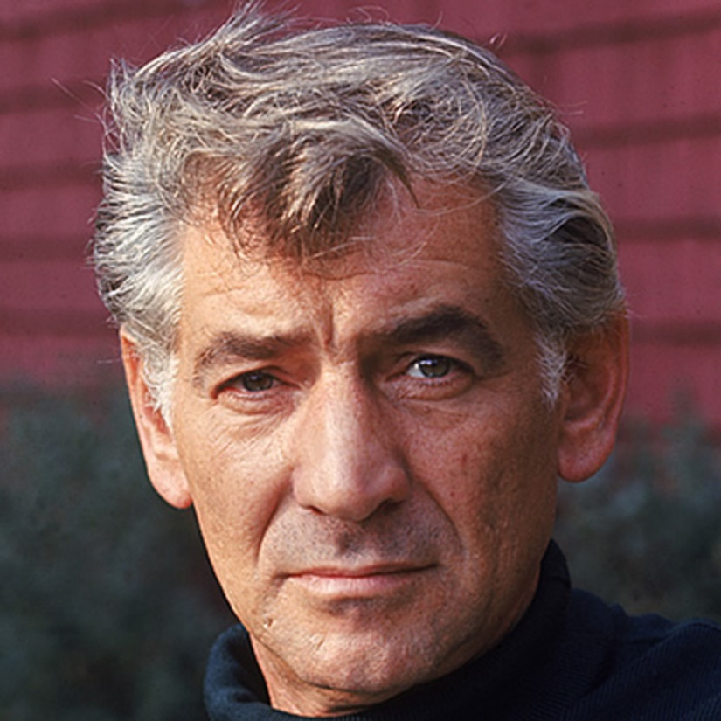
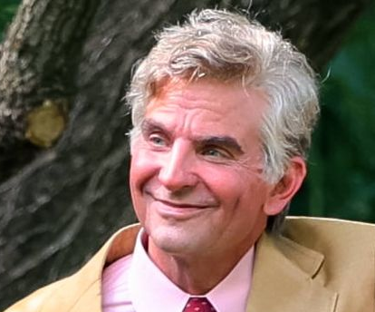
What music are we listening to?
FACTS
Conductor, pianist, composer. Recent film of his life Maestro starring Bradley Cooper. Was a huge admirer of Mahler.
Born in America
1918 - 1990
Wrote the music to West Side Story (1961) with lyricist, Stephen Sondheim.
Musician: Leonard Bernstein
Song: Cool

Slide 16
What music are we listening to?
FACTS
The first Russian composer whose music would make a lasting impression.
Lived 1840-1893 Russia
Also composed for ballets Sleeping Beauty, Romeo and Juliet, Nutcracker.
Composer: Pyotr Ilyich Tchaikovsky
Song: Romeo and Juliet

Slide 17
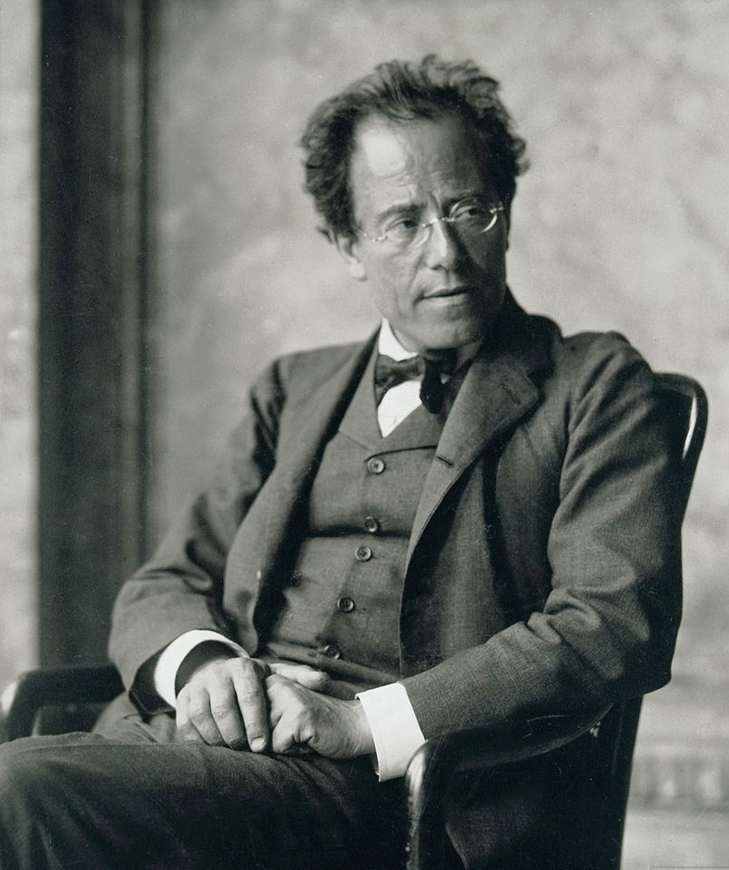
What music are we listening to?
FACTS
Conductor, composer
1860 – 1911 German
He wrote 9 symphonies (his 10th remains unfinished.) His music was banned by the Nazis during WW2 (probably because he was Jewish) In 2016, three of his symphonies were ranked in the top 10 of all time.
Musician: Gustav Mahler
Song: Symphony No.5

Slide 18

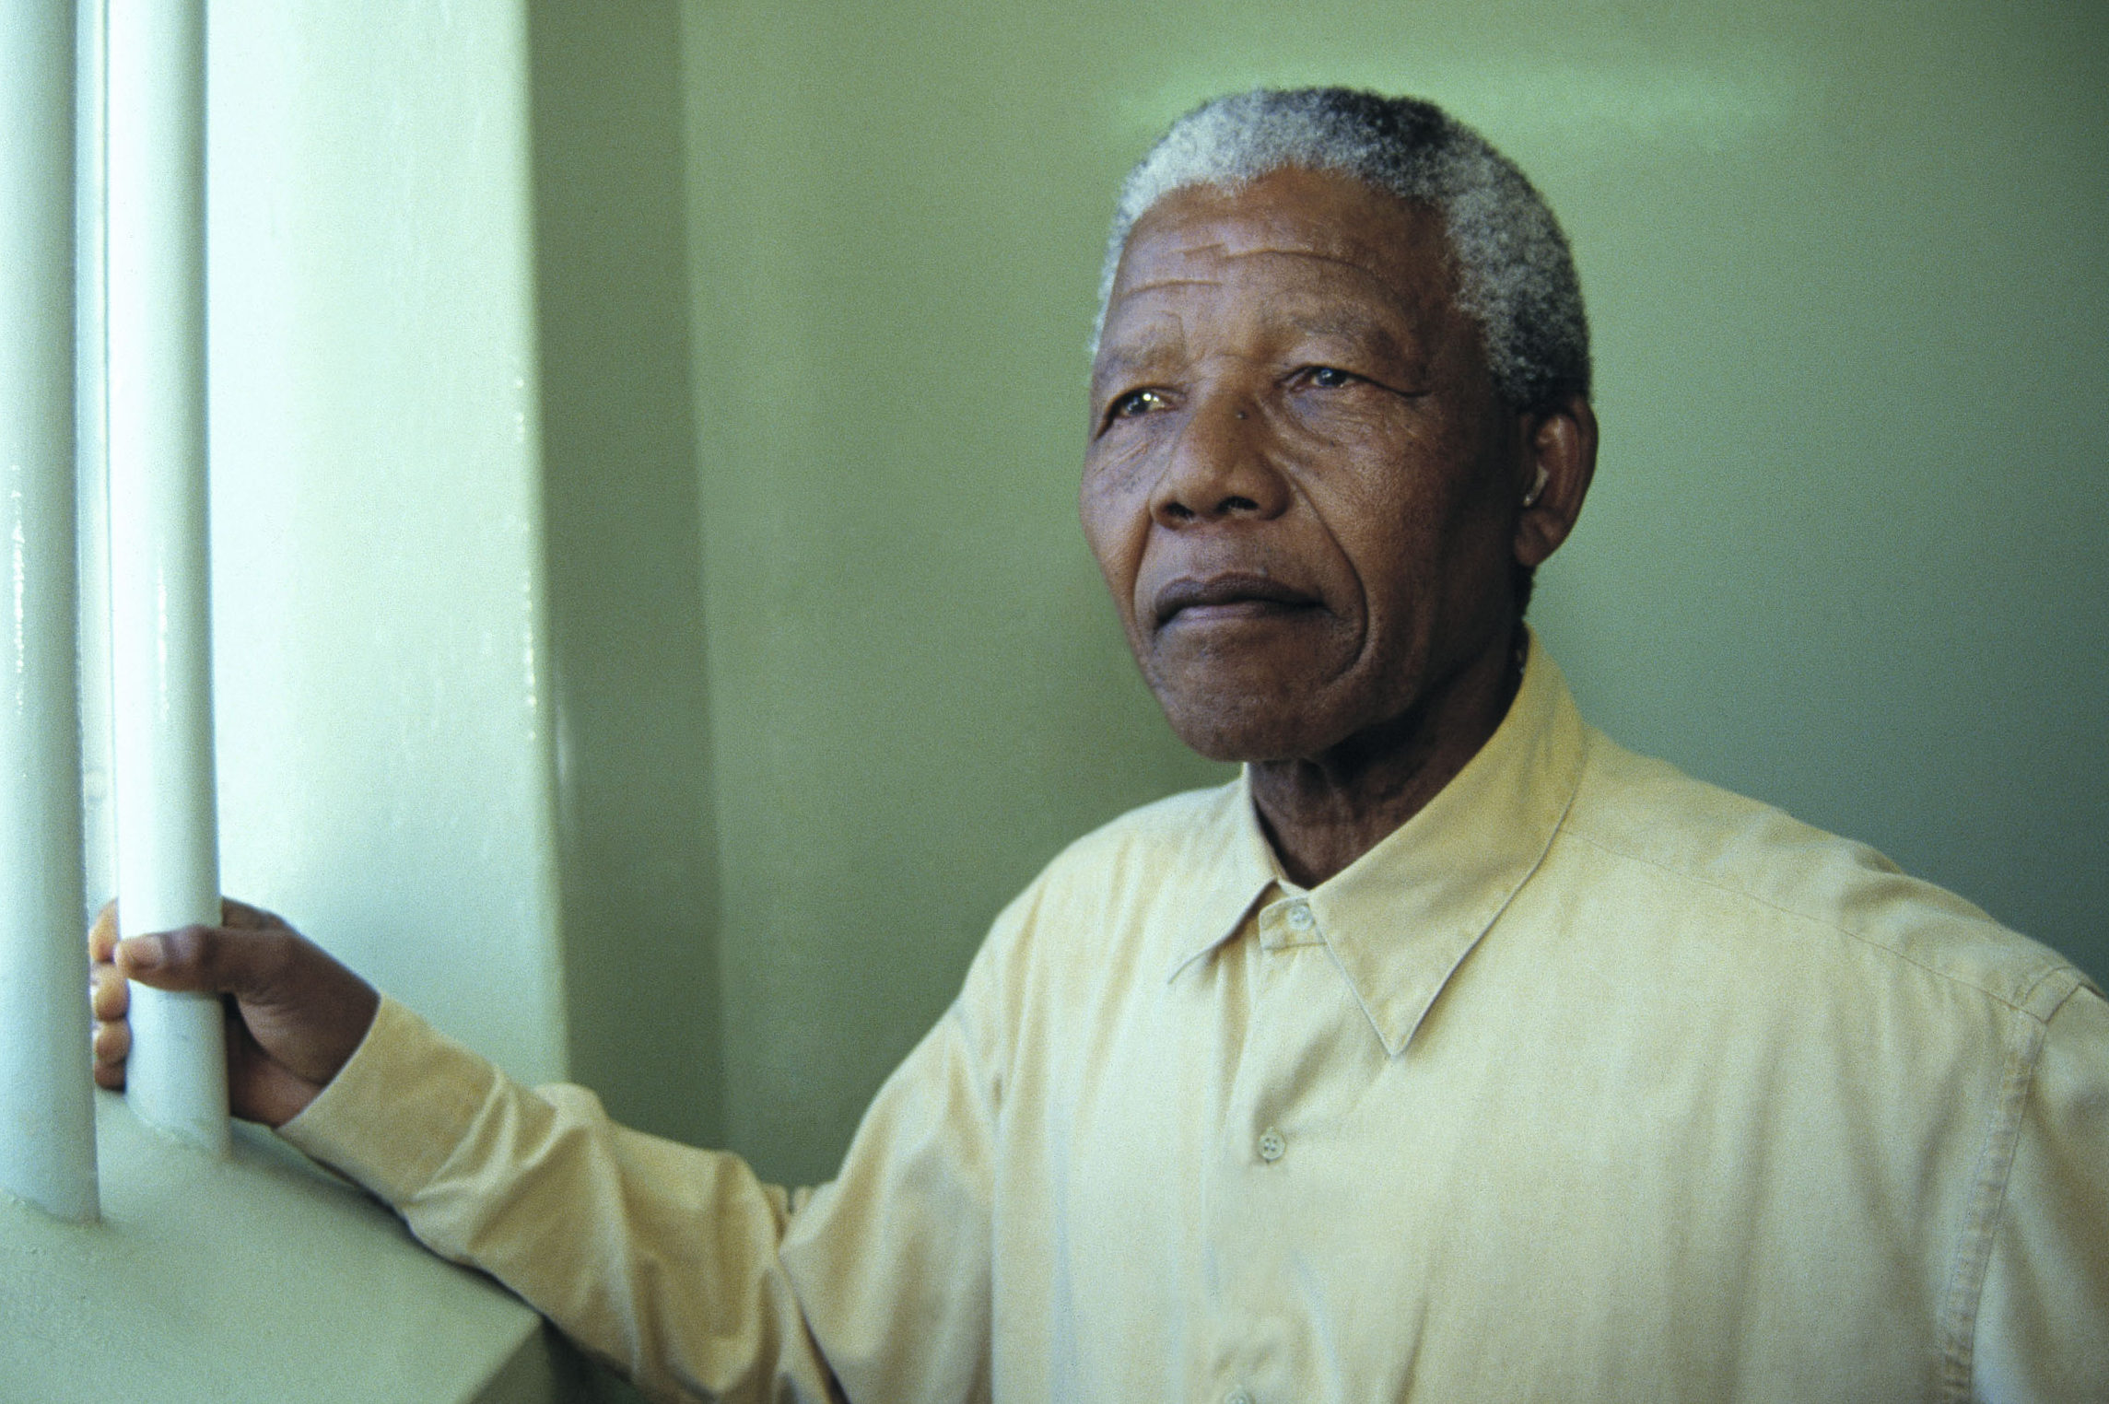
What music are we listening to?
FACTS
The Specials were a ska/two tone band from the 1970s. They were formed at the same time as a movement called Rock Against Racism. Their most recent album is one of protest songs.
Lead singer, Terry Hall, formed another band with two other members called Fun Boy Three.
Musician: The Specials
Song: Nelson Mandela

Slide 19

What music are we listening to?
FACTS
This song was composed in 2008 for the film Slumdog Millionaire which was directed by Danny Boyle.
Rahman composed it using an Apple Software called Logic Pro.
It is a typical Indian pop song. The phrase ‘Jai Ho’ means ‘Let there be victory.’
Musician: A.R. Rahman, directed by Danny Boyle
Song: Jai Ho (Pussycat Dolls)

Slide 20
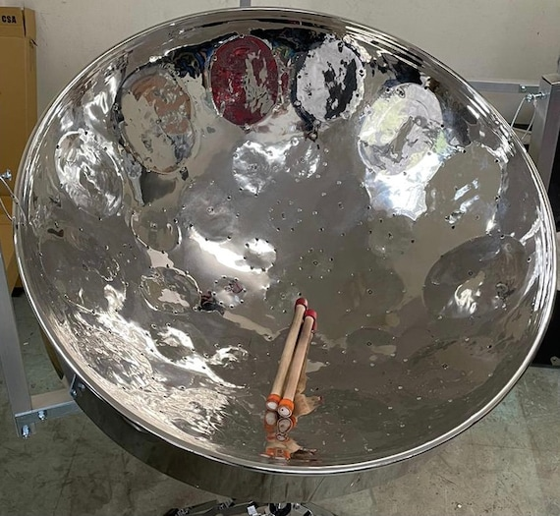
What music are we listening to?
FACTS
Steel drums are traditionally played in the Caribbean, having been created in the 1930s in Trinidad and Tobago by former slaves.
The drums were made from the bottom of oil pans.
They were played at the Notting Hill carnival for the first time in 1966.
This band won the annual UK Panorama competition in 2019.
Musician: Mangrove Band
Song: Savannah Grass

Slide 21
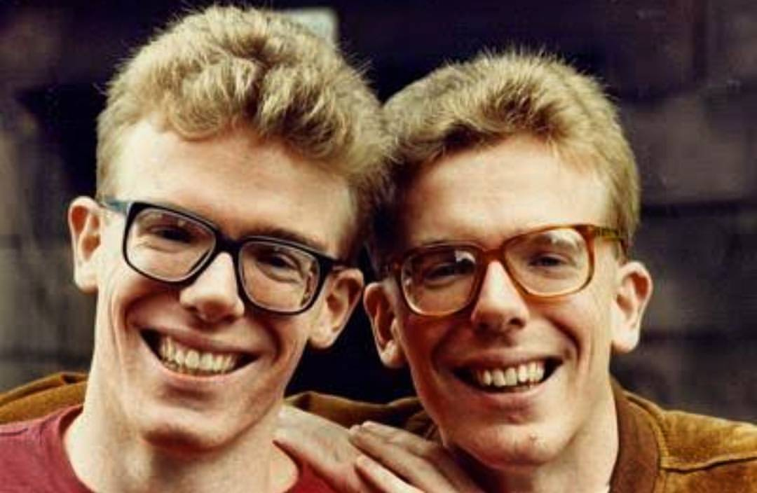

What music are we listening to?
FACTS
Craig and Charlie Reid are twins. They were born in 1962 in Leith, Edinburgh.
Their most well known song I’m Gonna Be (500 miles) was released in 1988. They are influenced by folk and post punk music.
The film Sunshine on Leith features their music.
Musicians: The Proclaimers
Song: I'm Gonna be (500 miles)

Slide 22
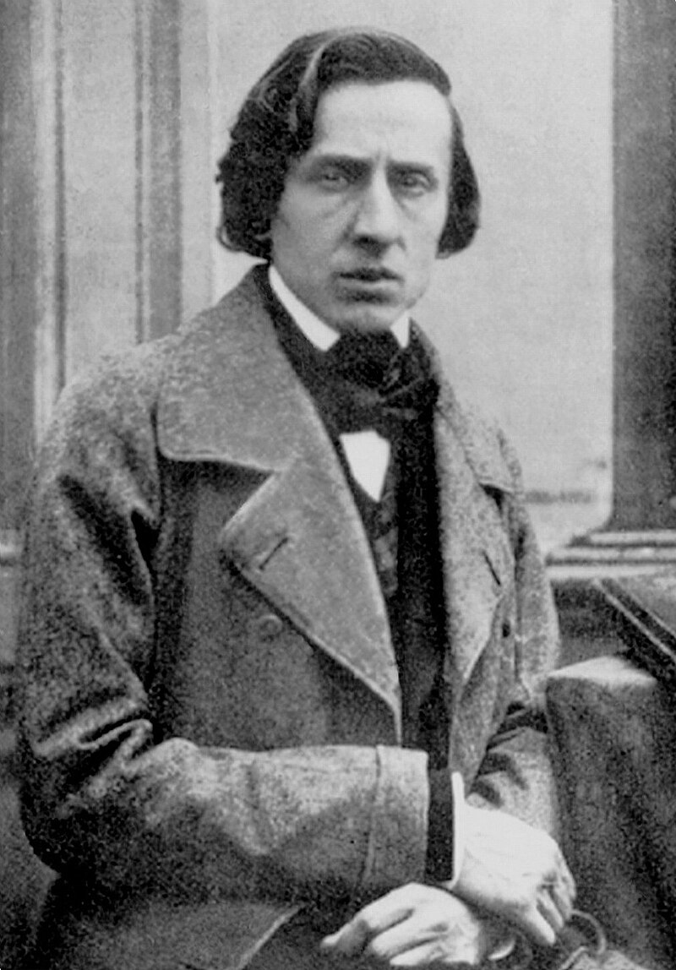
What music are we listening to?
FACTS
Born in Poland as Fryderyck Chopin and lived from 1810-1849.
He was a virtuoso pianist and composed almost exclusively for the piano.
In 1830, he moved to Paris and began to use the French version of his name (his father was French). In 1848 he moved to London and performed for Queen Victoria.
Composer: Frédéric Chopin
Song: Fantasie-impromptu

Slide 23
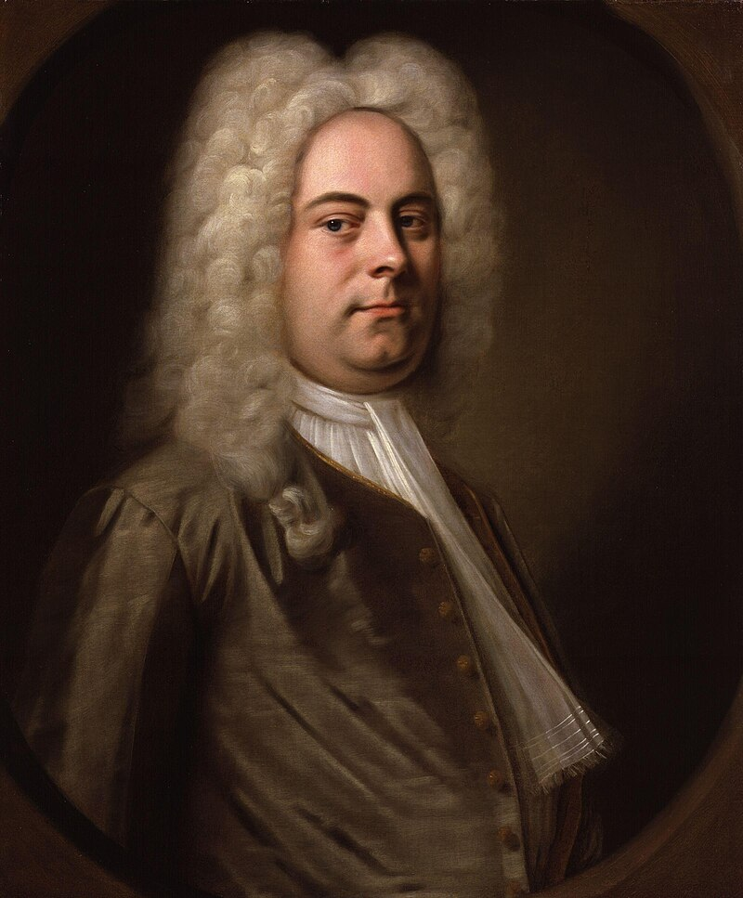
What music are we listening to?
FACTS
1685 – 1759
German-British composer of operas and anthems.
He lived in Hamburg for much of his life before moving to London.
The Royal Choral Society performs the Messiah every Good Friday at the Royal Albert Hall.
Composer: George Frideric Handel
Song: Hallelujah chorus

Slide 24
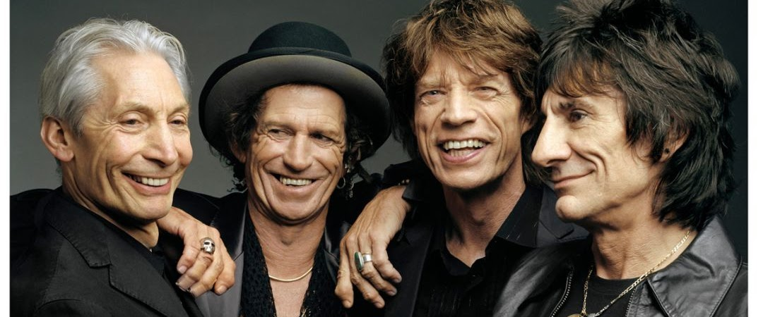
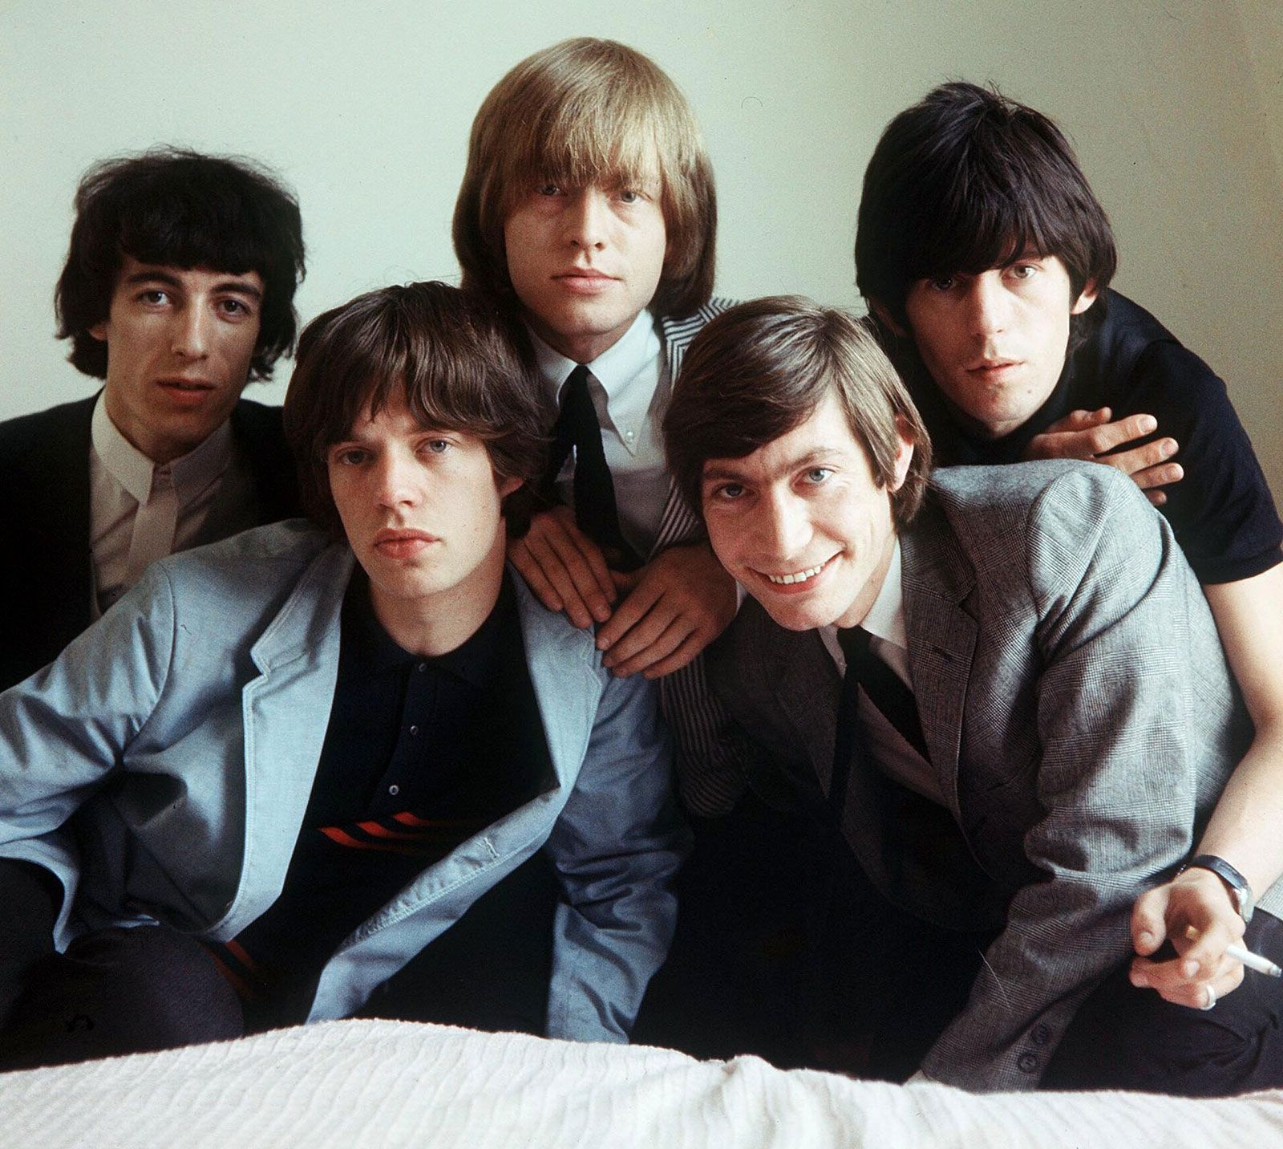
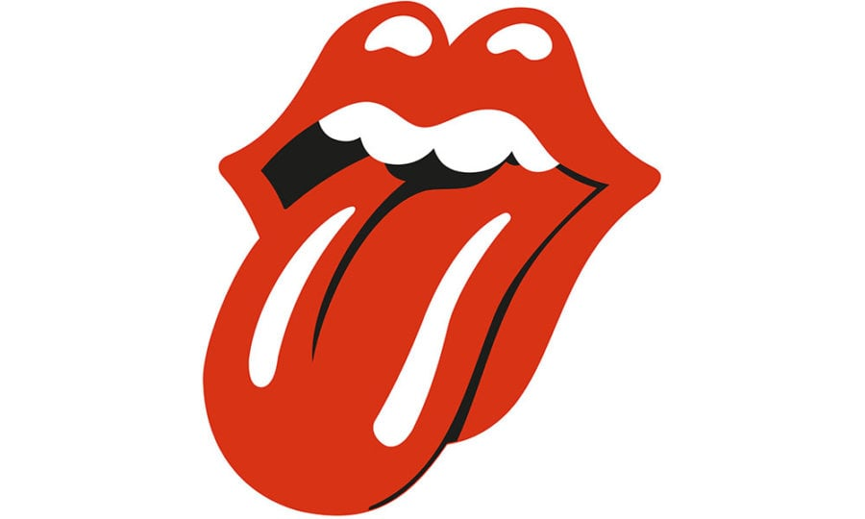
What music are we listening to?
FACTS
Mick Jagger – singer, songwriter
Keith Richards – guitar, songwriter
Charlie Watts – drums (died 2021)
Ronnie Wood – guitar
Bill Wyman – bass guitar
The Stones formed in 1962. They were most popular at the same time as the Beatles in the late 1960s. They are still performing in their 80s!
Band: The Rolling Stones
Song: Jumpin' Jack Flash

Slide 25
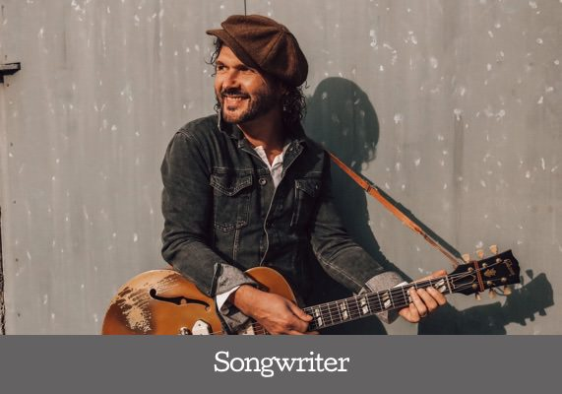
What music are we listening to?
FACTS
Born in Belfast, hence the Celtic sound to this song. (pipes and whistles)
Songwriter and musician. He writes songs based on those he was taught as a child. His album is called Songs from My Father.
He has shared the stage with famous musicians like Elvis Costello, Van Morrison, Robert Plant.
Anam cara means ‘soul friend.’
Musician: Brian Houston
Song: Anam Cara

Slide 26
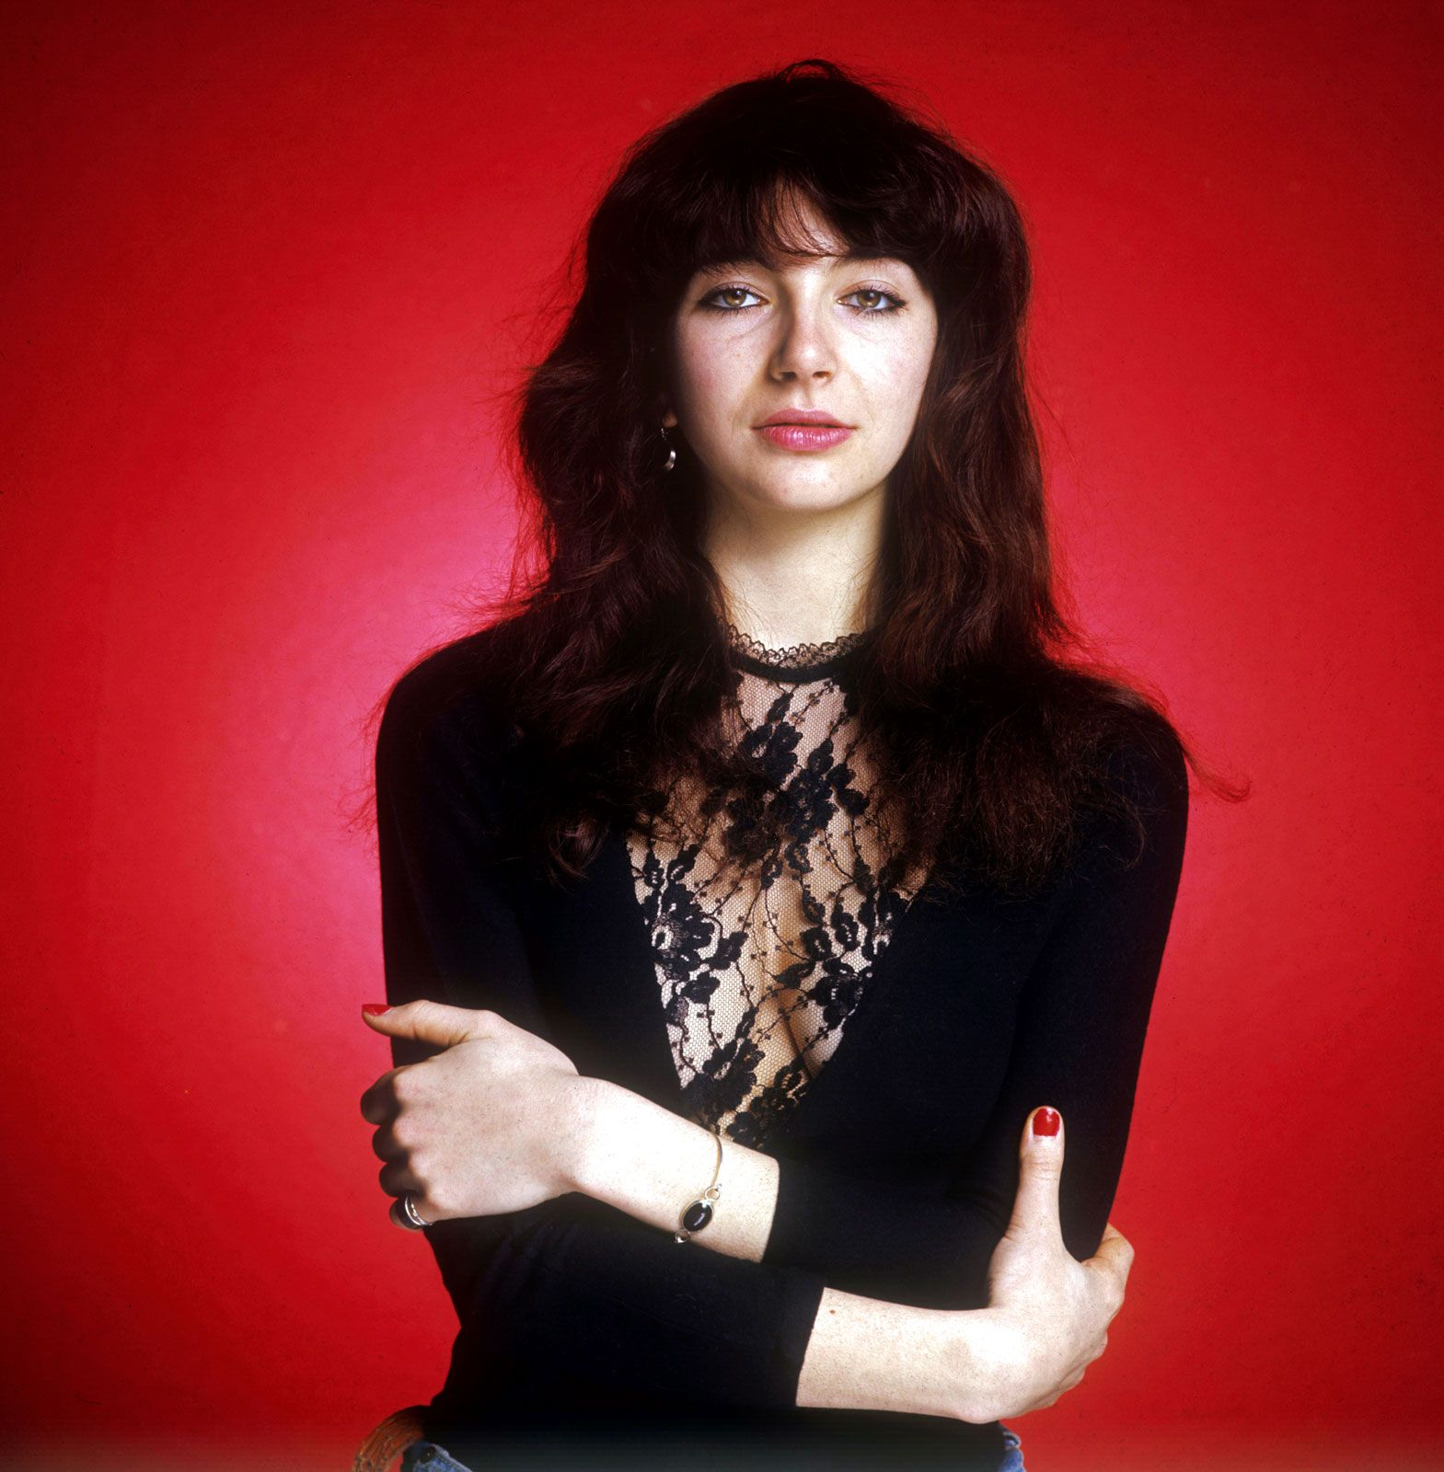
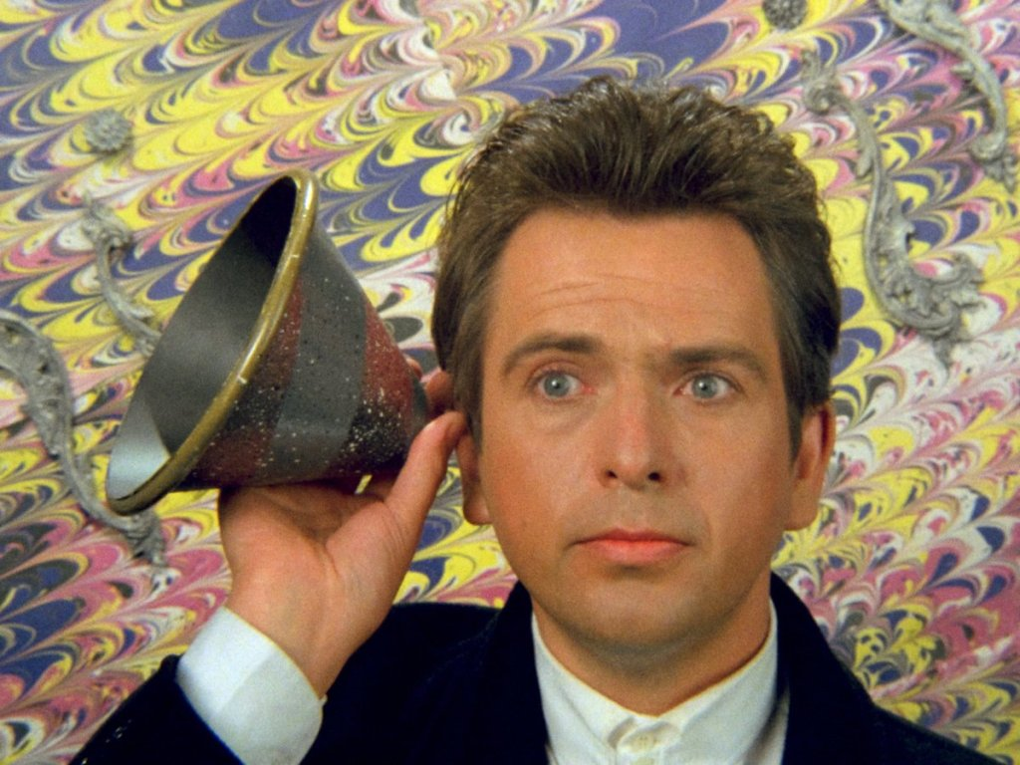
What music are we listening to?
FACTS
Born in 1950 in Chobham. He went to school in Woking.
Singer, songwriter, pianist, flautist
He was the original lead singer of Genesis.) His most successful solo song is Sledgehammer.
Musician: Peter Gabriel (ft Kate Bush)
Song: Don't give up

Slide 27
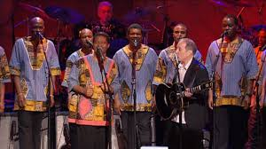
What music are we listening to?
FACTS
This song was taken form an album called Gracelands (1986).
When this was recorded, Apartheid was still in force in South Africa and Nelson Mandela was still in prison.
Paul Simon was criticised for touring with the African musicians but he loved African street music.
Musician: Paul Simon and Ladysmith Black Mambazo
Song: Diamonds on the soles of her shoes

Slide 28
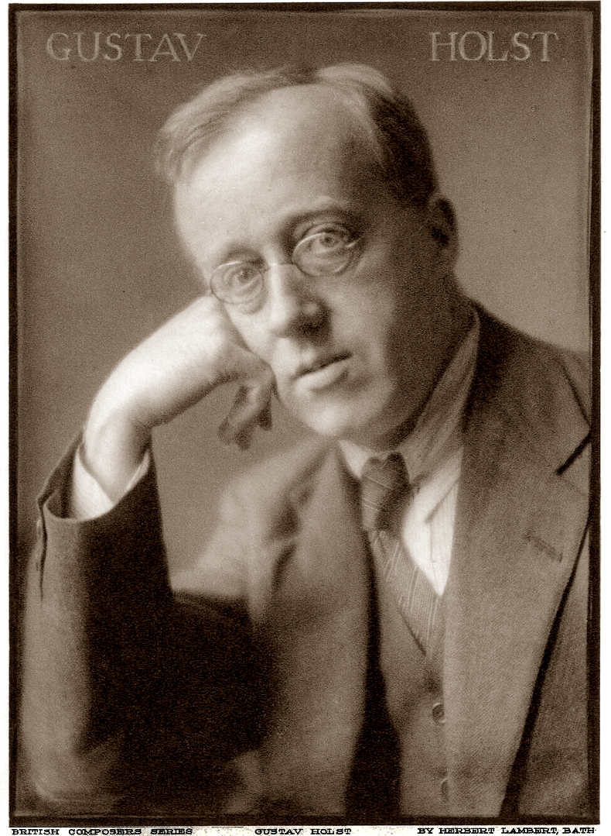
What music are we listening to?
FACTS
1874-1934 English
Studied at the Royal College of Music.
Composer, trombonist, teacher.
The Planets became successful just after WW1.
He was shy and didn’t like popularity.
He influenced Benjamin Britten.
Musician: Gustav Holst
Song: Venus

Slide 29
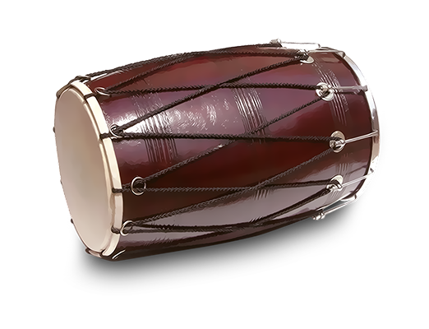
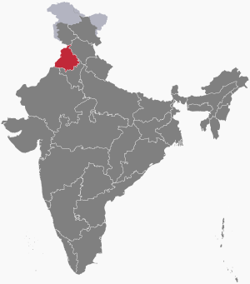

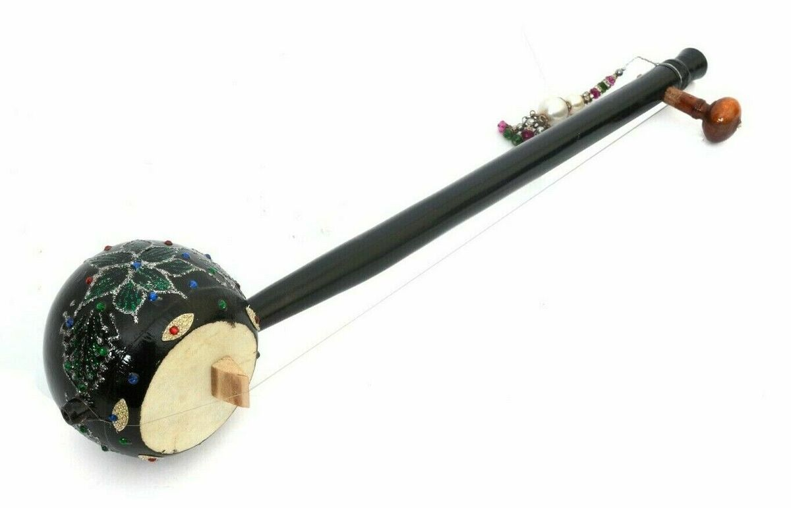
What music are we listening to?
FACTS
This is Bhangra music which comes from the Punjab in India -
a style which originated as a folk dance celebrated during the time of the harvest.
This song combines traditional Asian sounds with modern Western musical instruments and influences. It was created by the world’s longest running Bhangra band, who play the guitar, banjo and accordion as well as the dhol and tumbi.
Musicians: Bhujhangy Group
Song: Bhabiye Akh Larr Gayee

Slide 30
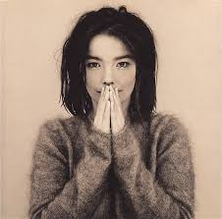

What music are we listening to?
FACTS
Björk is from Iceland. She is a singer, songwriter, composer, record producer, and actress.
She is known for her eclectic (adaptable) style and for the wide range of her voice (from low to high).
Musician: Björk
Song: It's oh so quiet

Slide 31
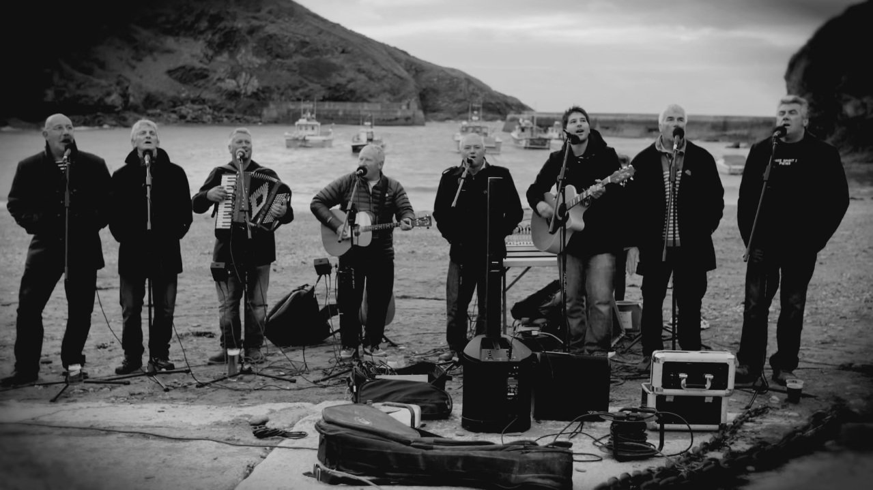

What music are we listening to?
FACTS
This band is made of a group of fisherman from Port Isaac. They used to gather together to sing sea shanties on the harbour and were persuaded to record their music.
A shanty is a folk song, sung to aid the rhythmic work of the sea.
Fisherman's Friend is a throat lozenge developed by pharmacist James Lofthouse in 1865 to relieve various respiratory problems suffered by fishermen working in the extreme conditions of the northern deep-sea fishing grounds.
Musicians: Fisherman’s Friends
Song: Sloop John B

Slide 32
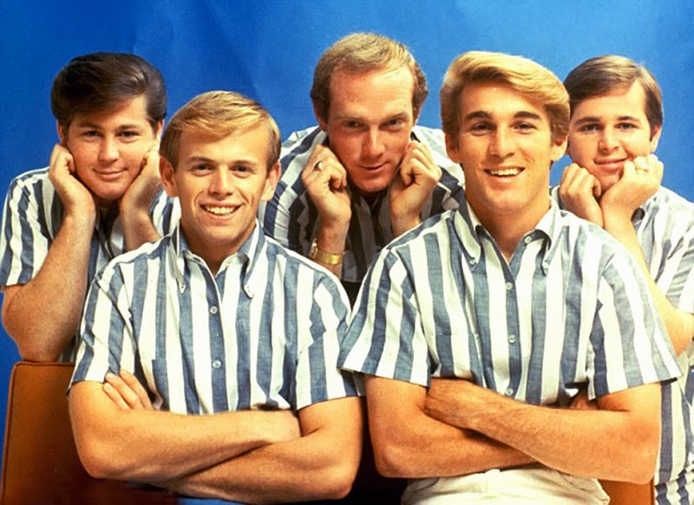
What music are we listening to?
FACTS
Formed in California in 1961. Two brothers, a cousin and a friend.
Their music focused on the interests of young people in the 1960s: surfing, romance and cars. It was nicknamed the Californian style.
The Beach Boys are one of the most commercially successful bands of all time, selling over 100million records.
Musicians: Beach Boys
Song: Good vibrations

Slide 33
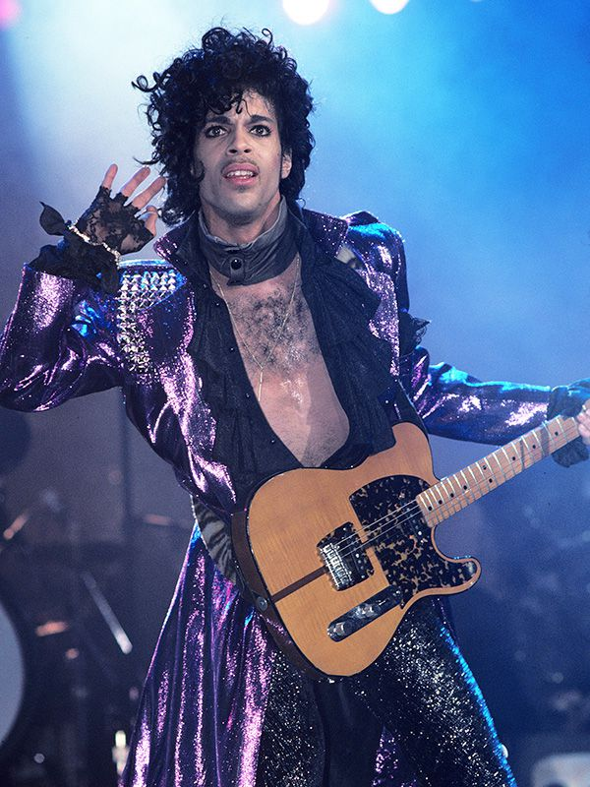
What music are we listening to?
FACTS
Prince Rogers Nelson was from Minneapolis, America and lived from 1958 – 2016. His backing band was called The Revolution.
He was a singer, songwriter, musician (guitar, keybard, bass, drums), record producer and
actor. He came from a very musical family and also wrote songs for other artists. He trained in classical ballet as a young man.
His film, Purple Rain, featured his songs and resulted in the album spending 24 weeks at number 1.
Musicians: Prince
Song: Raspberry Beret

Slide 34
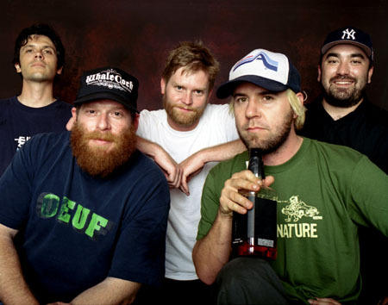
What music are we listening to?
FACTS
American indie band from California. 1992-2006, then split but re-formed in 2006.
The lead singer was a professional skateboarder but was injured so turned to music instead. Many of their first performances were at skateboarding competitions.
The band was influenced by many 1980s bands such as Thompson Twins, OMD, Human League, Depeche Mode.
Musicians: Grandaddy
Song: Nature anthem

